Slide 1
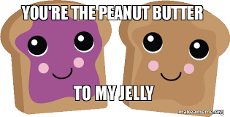
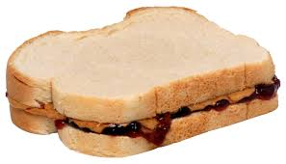
Thursday 8/26/2021 – Activator
Directions: FIRST, get your science journal. NEXT, put your CER from yesterday in the tray on the front table. Lastly, read the statement below and follow the directions.
Scientists often have to create and/or follow procedures. Procedures are a series of actions conducted in a certain order. Write the procedure someone would need to follow in order to make a peanut butter and jelly sandwich.
Peanut Butter Jelly Time Song

Slide 2
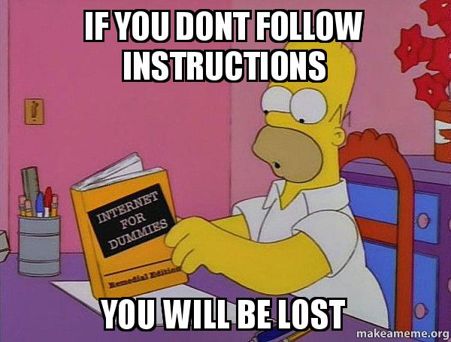
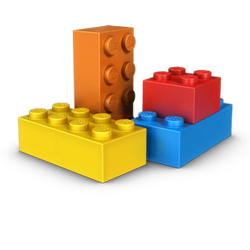
Thursday 8/26/2021
Steps for today…..
Lego Creations and Writing Procedural Instructions
Your entire table is working with the exact same Lego pieces.
You and your elbow partner will build something and create instructions. The people across from you at your table will then try to recreate the same creation based only on the instructions you provide!!
Do not let your table opponents see your Lego creation!
Do not take anything apart until told to do so!
Do not mix up the pieces and make sure they stay with the bag they belong in.

Slide 3
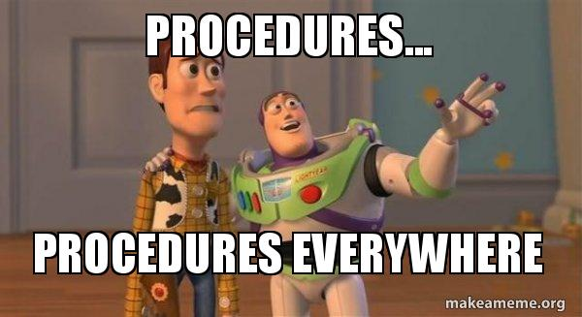
Friday 8/27/2021 - Activator
Directions: Get your science journal. Read the statement and follow the directions.
You made a lego structure and created procedures for someone else to be able to recreate your same exact structure. Reflect on the activity by thinking about the questions below and then write a few sentences to respond in your journal.
-What made procedures easier or harder to follow?
-How do you create accurate procedures?
-What do “good” procedures include?
Science Stars in butterfly bin for drawing!!

Slide 4
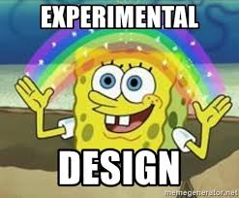
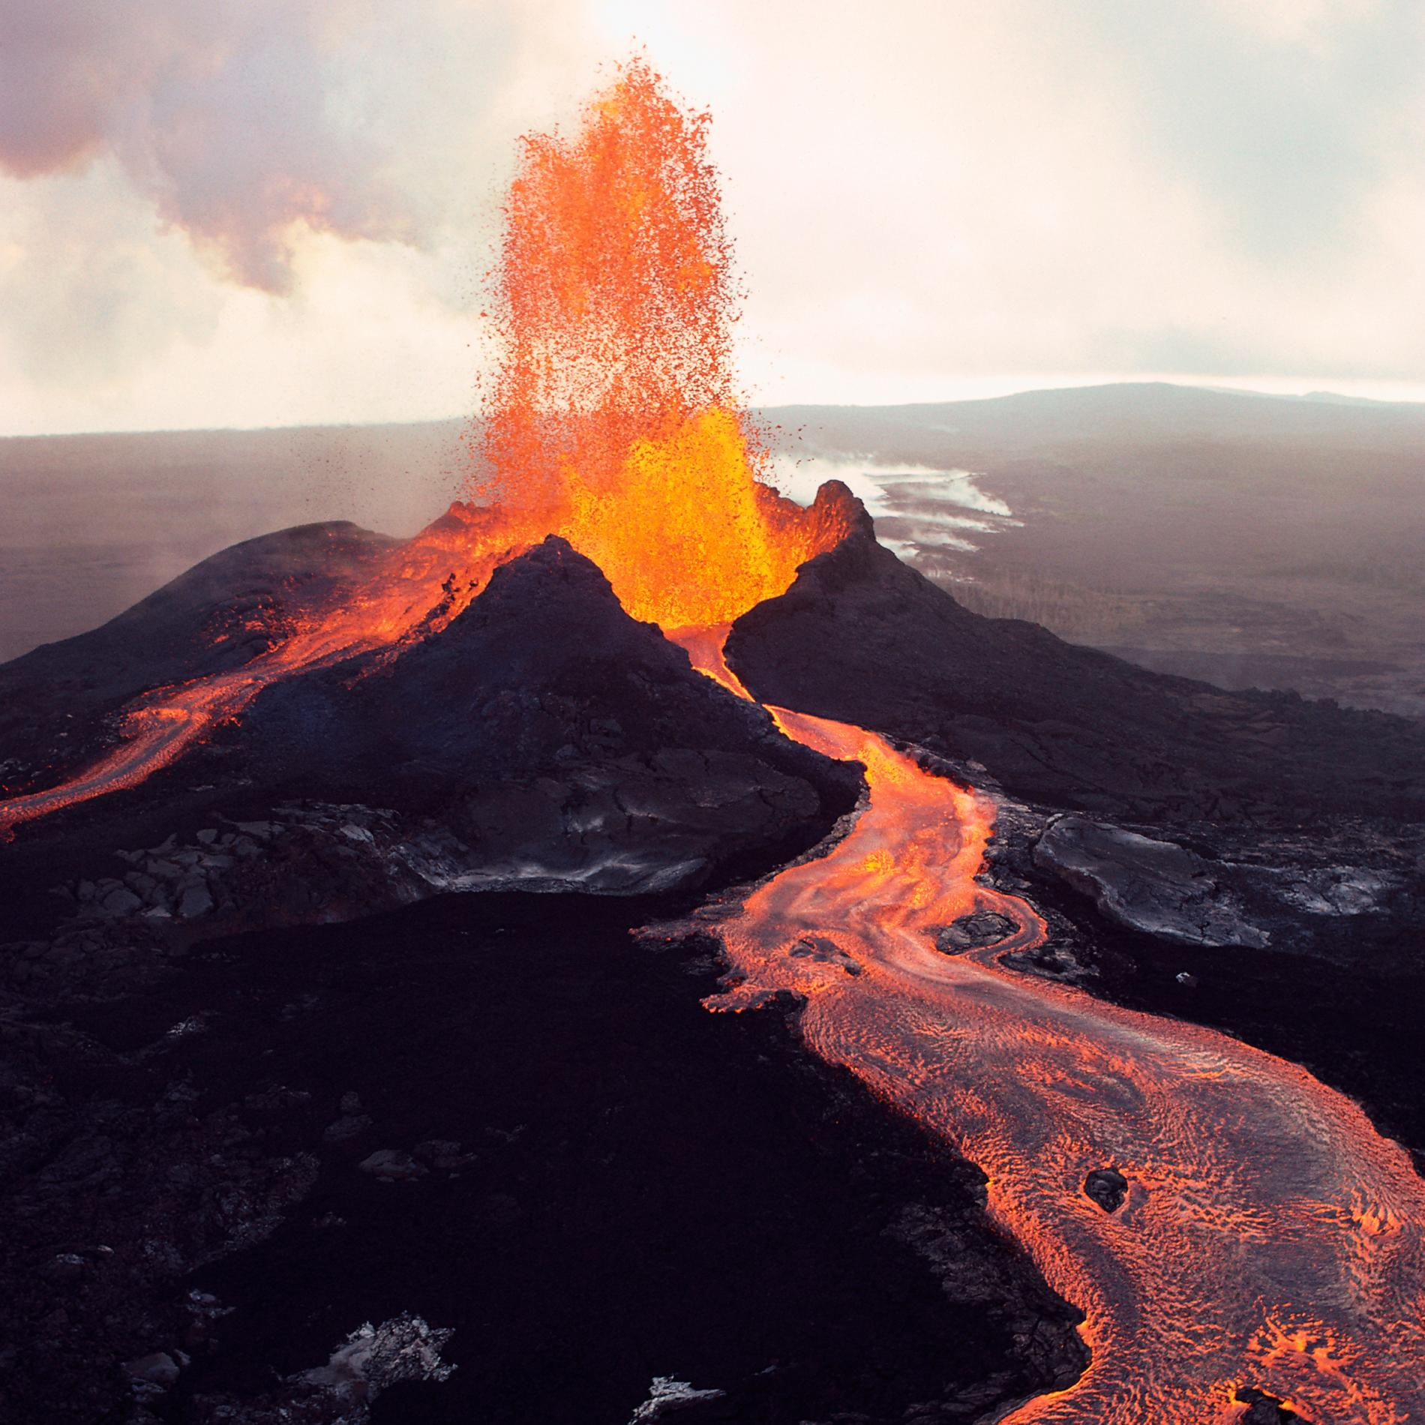
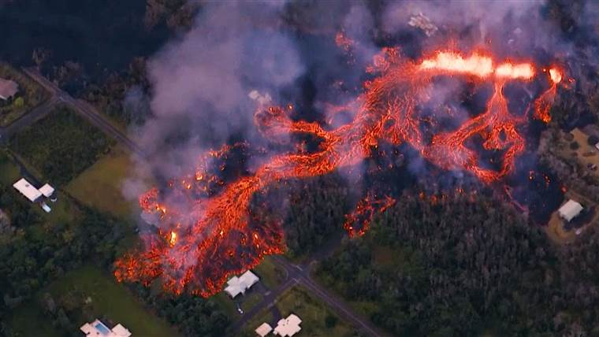
Friday 8/27/2021
Steps for today…..
Begin Lava Flow AMP-IT-UP Challenge
Model design and procedures
Plan your investigation (Don’t draw or mark materials for real today!)
Write out your procedures
CNN Lava Flow Video from reading pack

Slide 5
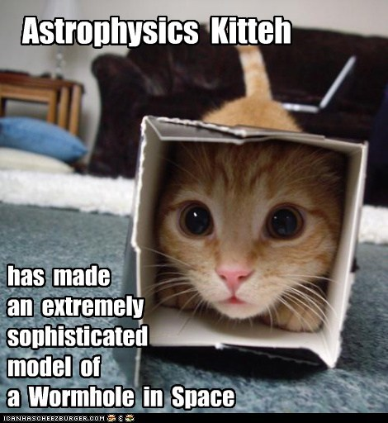
Monday 8/30/2021 - Activator
Directions: First get your science journal. NEXT, reflect on and answer the following questions in your journal. You do not need to copy the questions if you answer in complete sentences! Lastly, read back over your lab safety rules!! We are doing a lab today!!
What is a model?
Why do we use and create models?
What are some examples of models people and scientists use?
What are we working on making a model of?

Slide 6
Monday 8/30/2021 – Activator KEY
Directions: First get your science journal. NEXT, reflect on and answer the following questions in your journal. You do not need to copy the questions if you answer in complete sentences! Lastly, read back over your lab safety rules!! We are doing a lab today!!
What is a model?
Why do we use and create models?
What are some examples of models people and scientists use?
What are we working on making a model of?
A model is something that represents something else.
We use models to help us understand things better.
Some other types of models are model roller coasters, wave machines, weather models, etc.
We are making a model of a volcano to test the speed of lava flow.

Slide 7
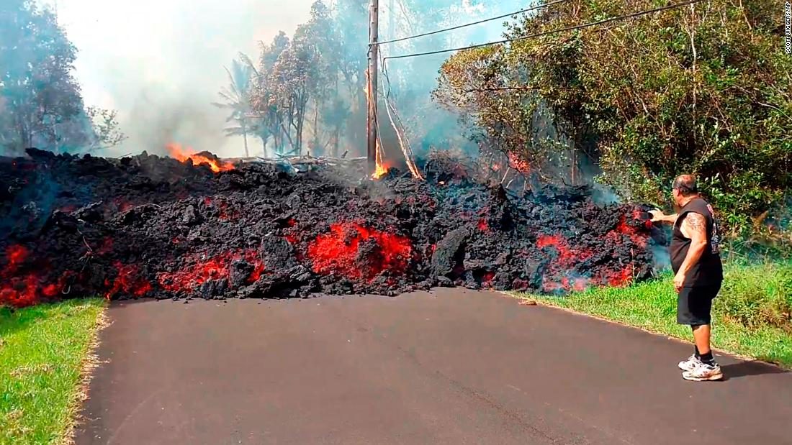
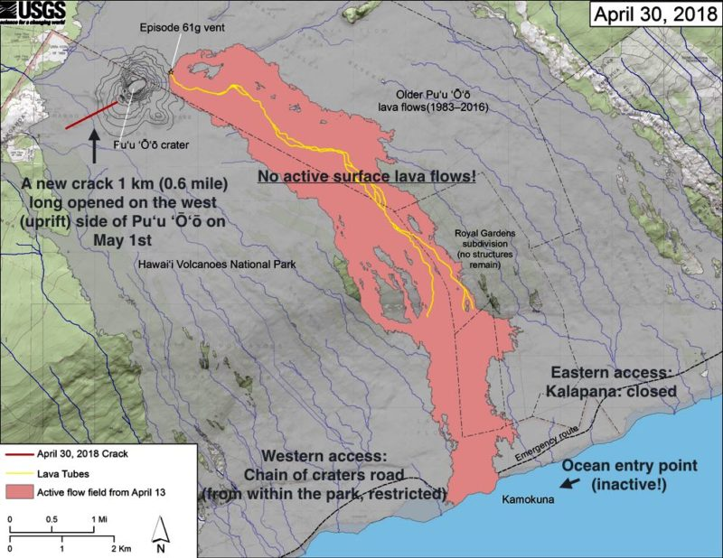
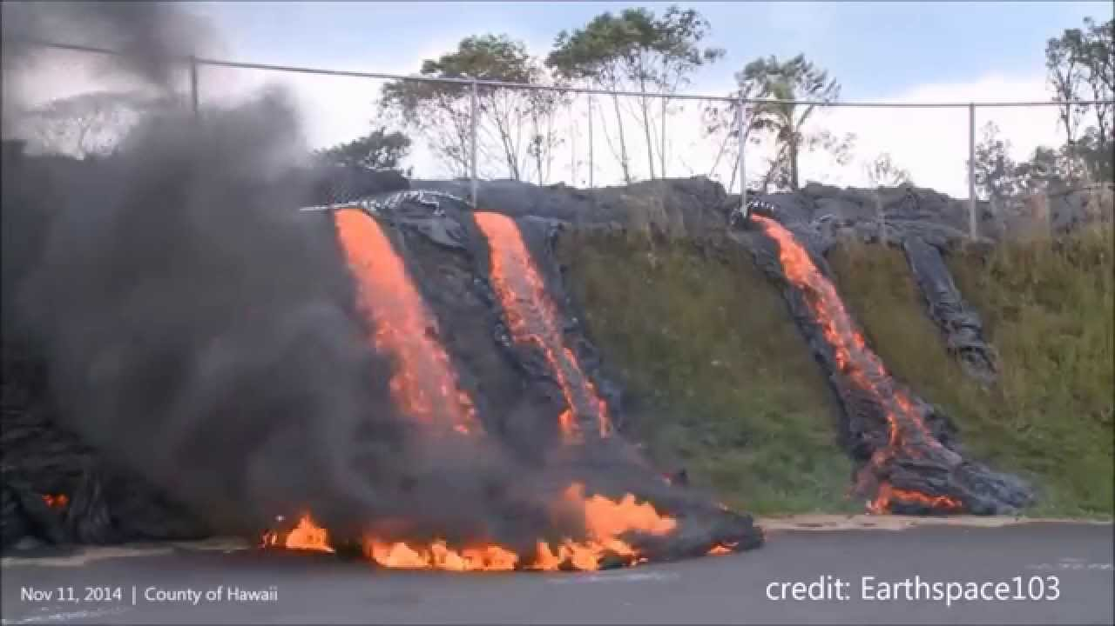
Monday 8/30/2021
Steps for today……
Lava Flow AMP-IT-UP Challenge
Run trials and collect data!
Follow your group’s procedure up to 6 times or until the time runs out. Record your data!

Slide 8
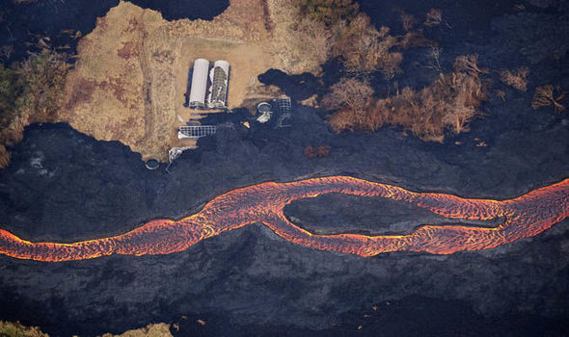
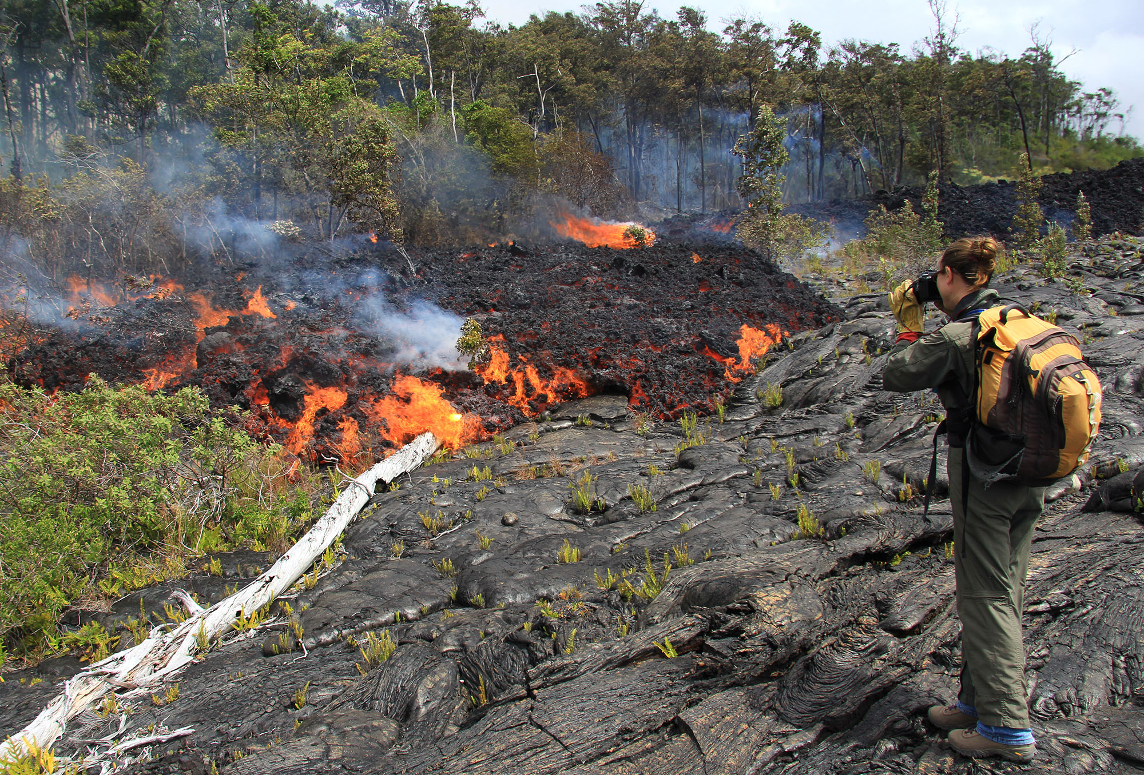
Monday 8/30/2021
Clean Up…….
All areas need to be wiped and dried off
Trash in the trash cans or trash bags
Eye goggles will go back in sanitizer box when I call your group
Plates rinsed and dried off
If the next group can’t use it, throw it in the trash
White and clear cups rinsed and dried off
If the next group can’t use it, throw it in the trash
Bins left how you found them
In front of a sink with a timer, ruler, and a marker
Clean and dried off plate, white cup, and clear cup if reusable
Soap clean and dried off sitting next to the sink
You are seated at your assigned seat when this is all done.

Slide 9
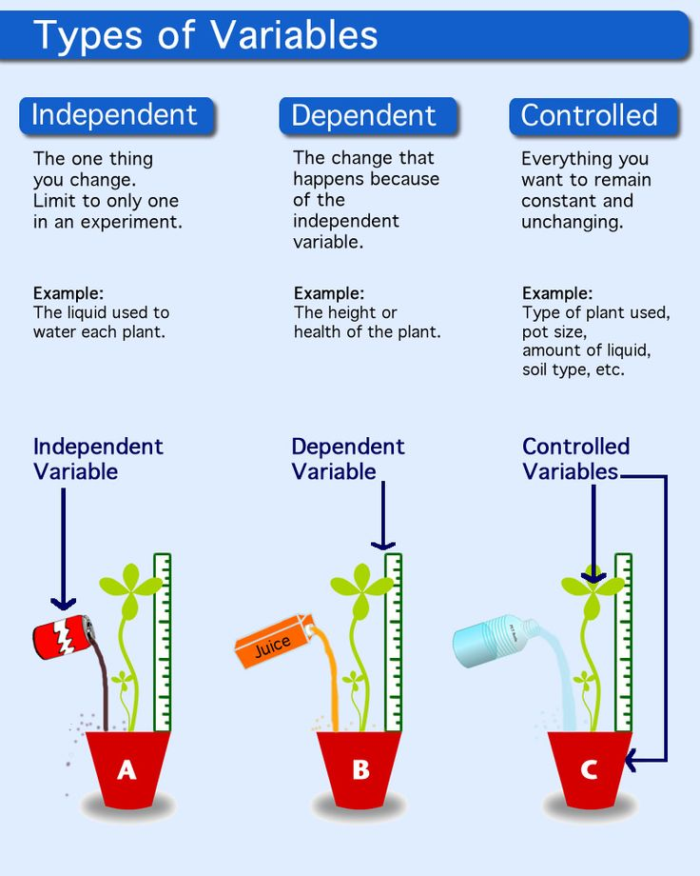
Tuesday 8/31/2021 - Activator
Directions: Get your journal. Copy the information in the blue boxes. Then, MATCH the terms to the correct definitions. Use the picture for help.
A. Model | One element that is not changed throughout an experiment
B. Consistency | A representation of an idea, object, or process
C. Variable | Using the same procedure repeatedly to collect data
D. Controlled Variable | Any part of of the procedure that could change

Slide 10
Tuesday 8/31/2021 - Activator KEY
Directions: Get your journal. Copy the information in the blue boxes. Then, MATCH the terms to the correct definitions. Use the picture for help.
A. Model | One element that is not changed throughout an experiment
B. Consistency | A representation of an idea, object, or process
C. Variable | Using the same procedure repeatedly to collect data
D. Controlled Variable | Any part of of the procedure that could change
D
A
B
C

Slide 11
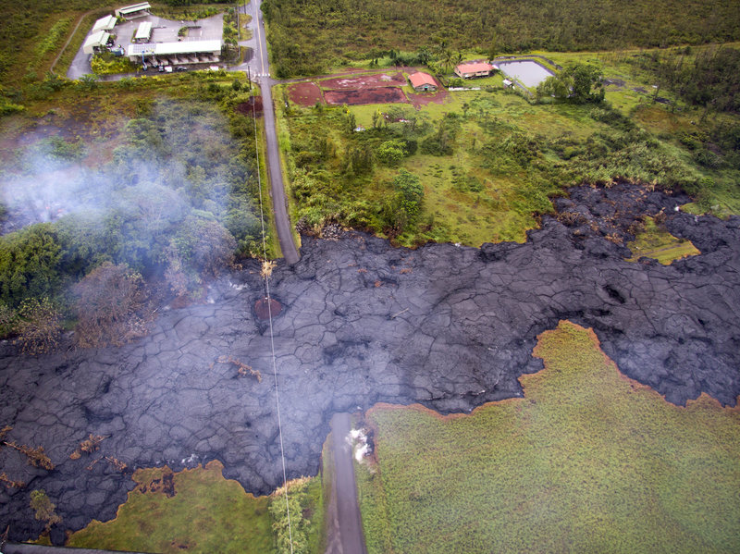
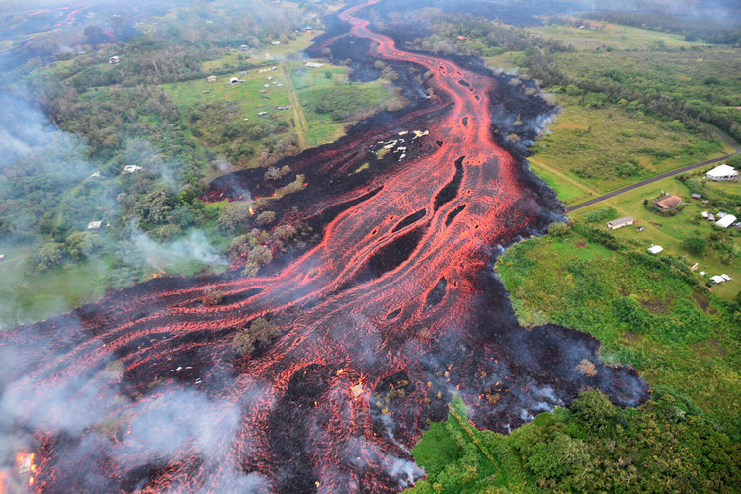
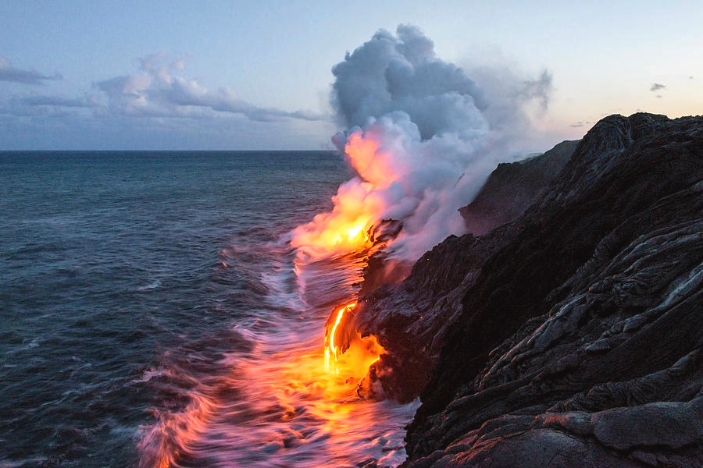
Tuesday 8/31/2021
Steps for today……
AMP-IT-UP Lava Flow Challenge Continued
Analyze the data
Add to our understanding of “Trustworthy Investigations”
Create a new and improved CONSISTENT procedure to test tomorrow!

Slide 12
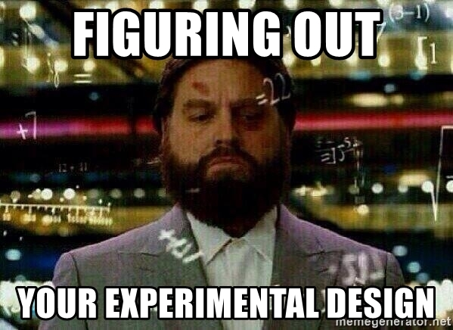
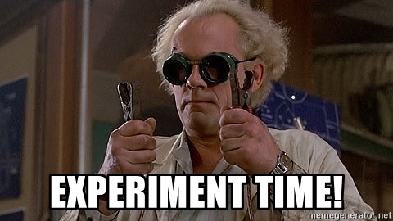
Wednesday 9/1/2021 - Activator
Directions: First get your science journal. NEXT, read and respond to the following questions in your journal. You do not need to copy the questions if you answer in complete sentences!
Experimental Design
Reflect on your lava flow model:
1. What are three or four key differences between your group’s previous procedure and the new class procedure?
2. What are you now controlling better in the new procedure?
3. What effect do you think this new procedure will have on the range of results across groups? (What should the histogram look like?)

Slide 13
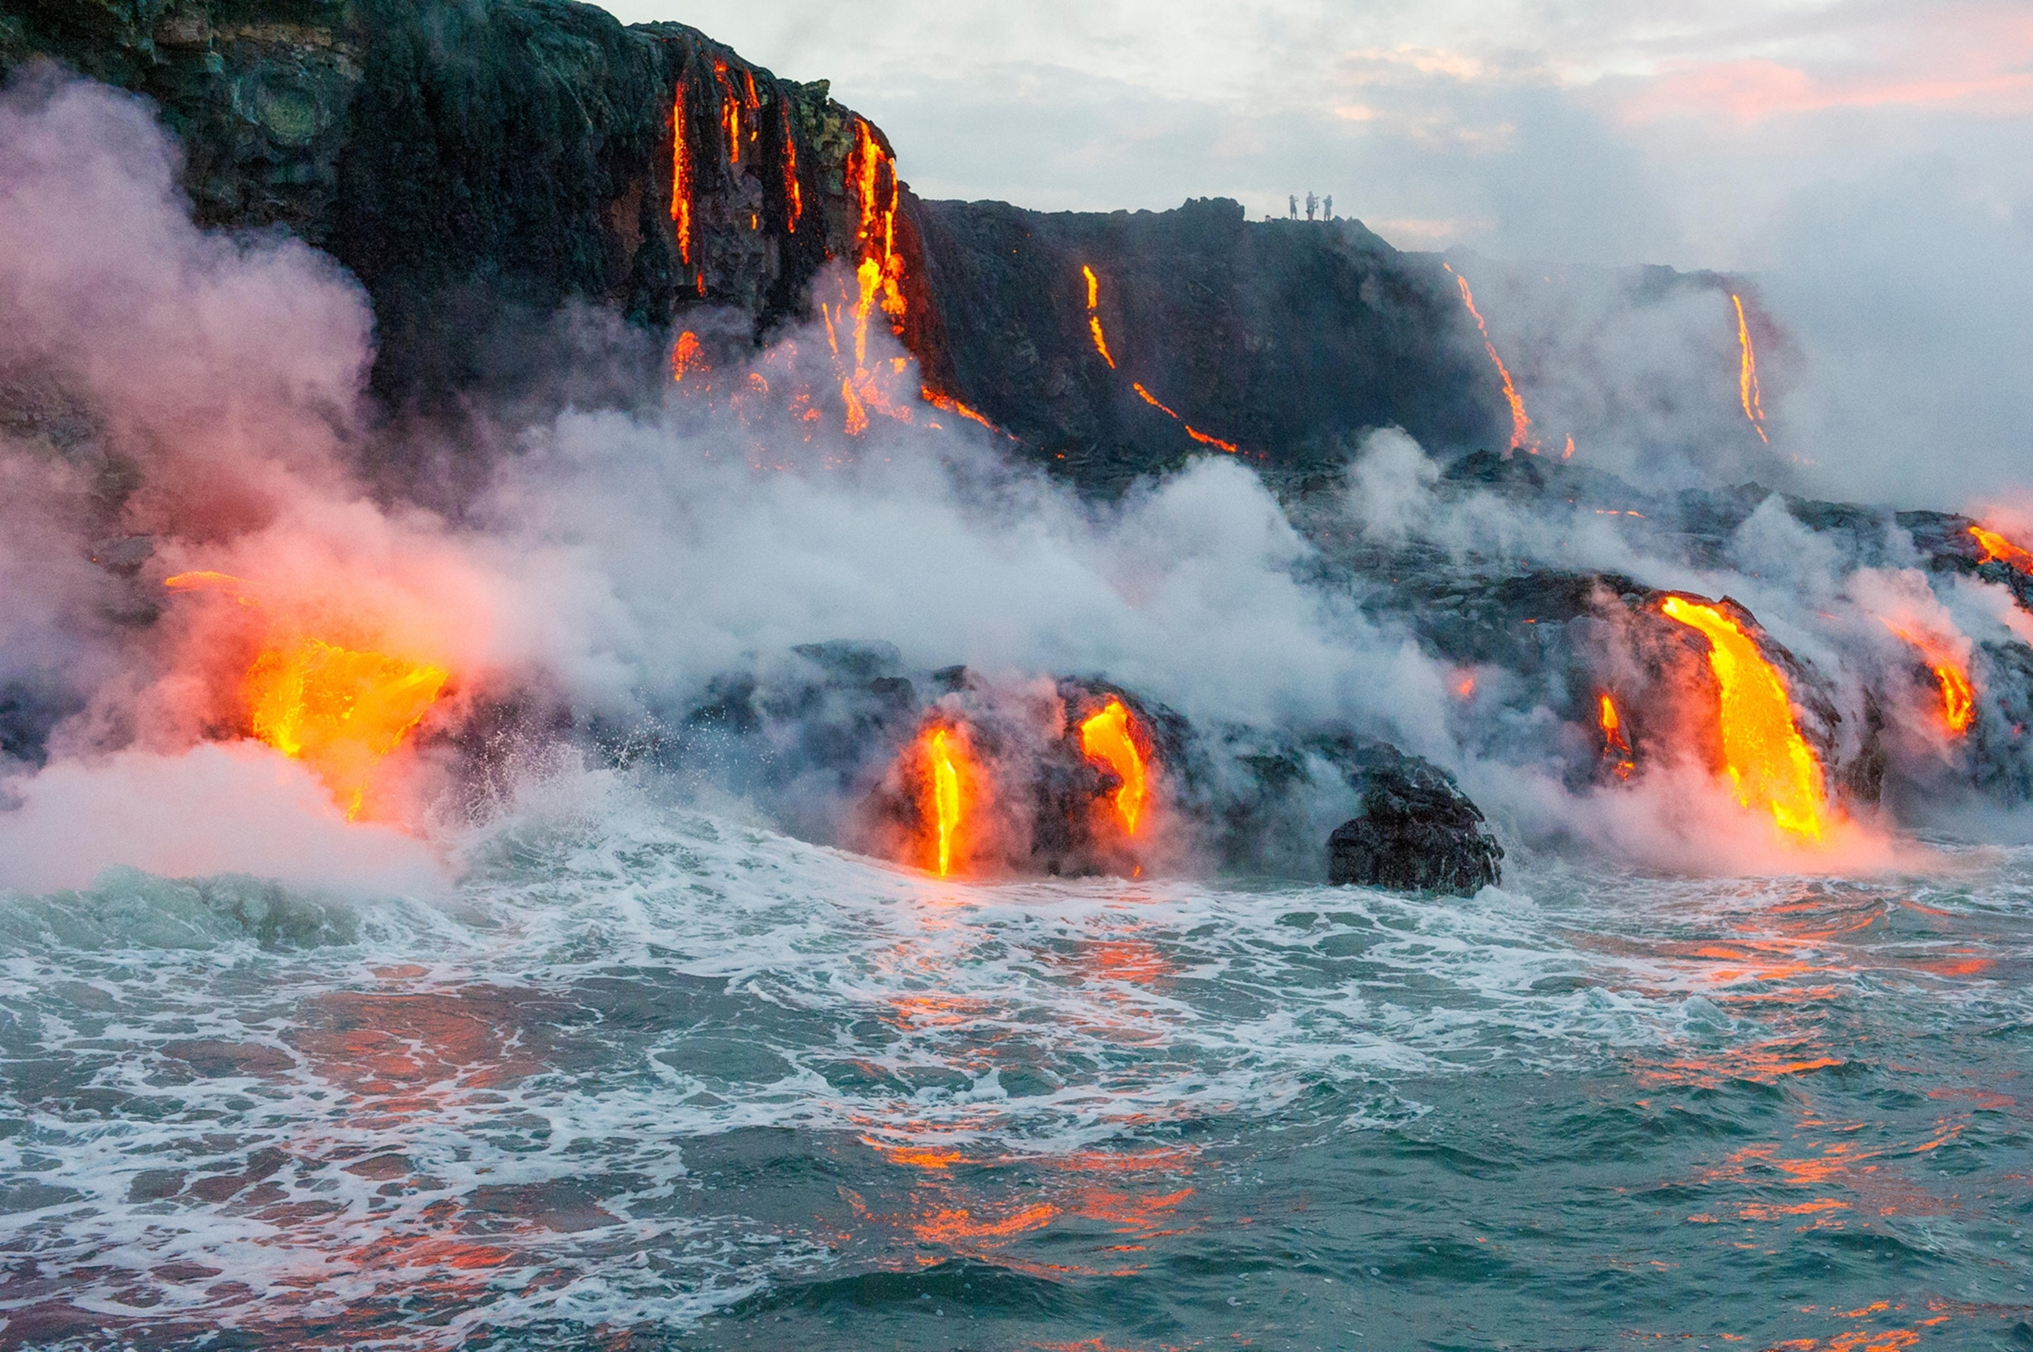
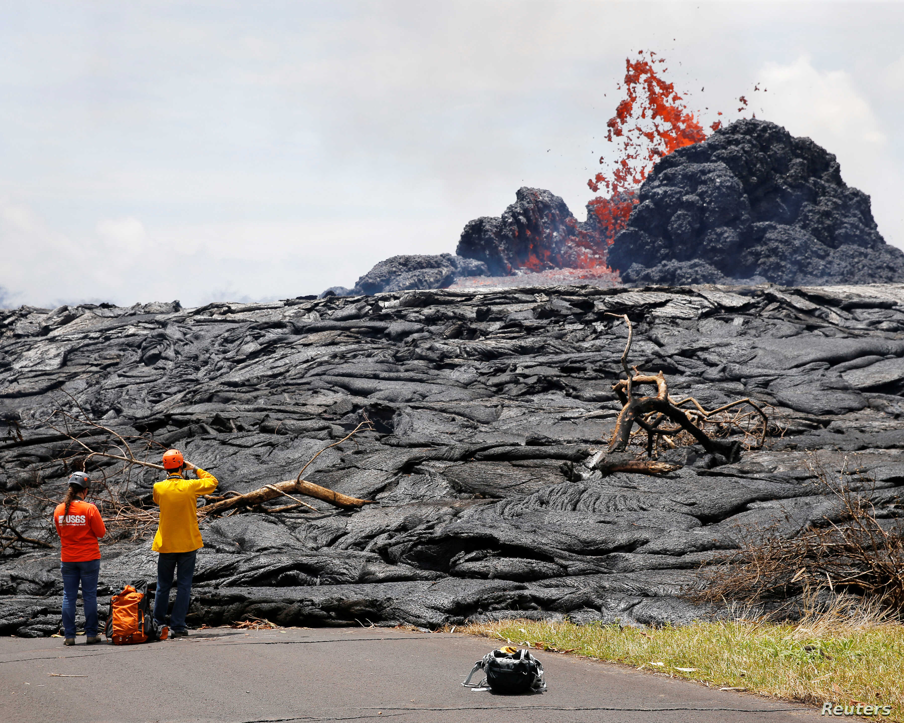
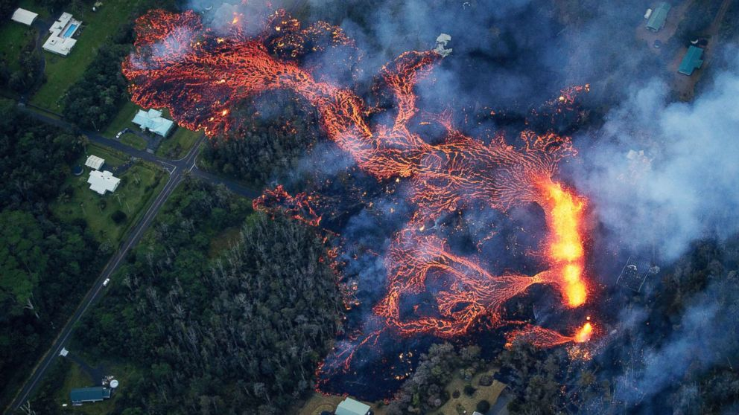
Wednesday 9/1/2021
Steps for today…..
AMP-IT-UP Lava Flow Challenge Continued
Test new procedures!
Hair pulled back, long sleeves pulled back, and safety goggles on!

Slide 14
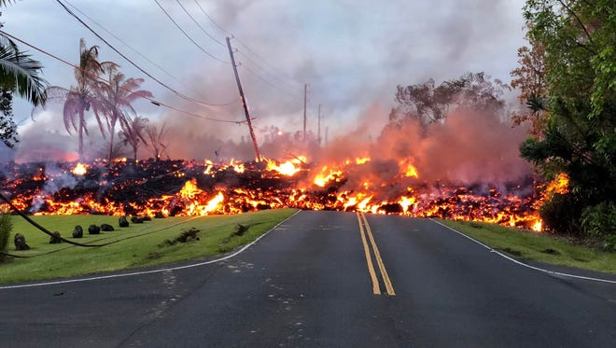
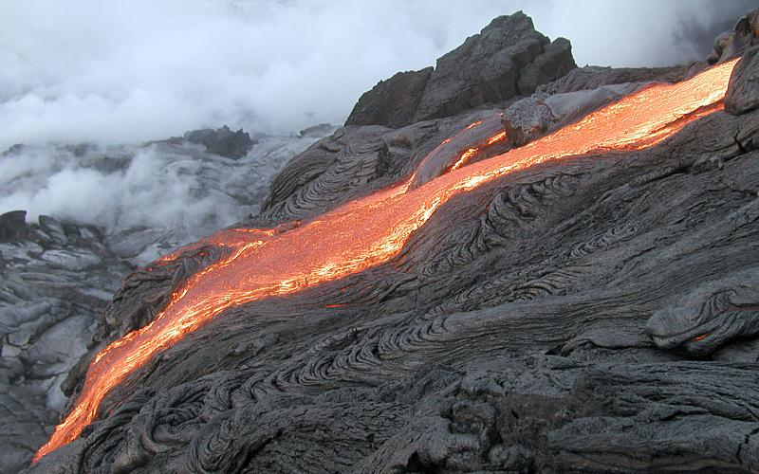
Wednesday 9/1/2021
Clean Up…….
All areas need to be wiped and dried off
Trash in the trash cans or trash bags
Eye goggles will go back in sanitizer box when I call your group
Plates and clear cups thrown in the trash
White cup rinsed, dried off, and back in the bin
Bins left how you found them
In front of a sink with a clean/dry white cup, timer, ruler, and a marker
Soap clean and dried off sitting next to the sink
You are seated at your assigned seat when this is all done.

Slide 15
Tuesday 9/14/2021 - Activator
Directions: First get your science journal. NEXT, read and respond to the following questions in your journal. You do not need to copy the questions if you answer in complete sentences! Use my sentence starters!!
Experimental Design-Reflect on your lava flow model:
1. What are three or four key differences between your group’s previous procedure and the new class procedure?
Three or four differences are……..
2. What are you now controlling better in the new procedure?
Now we are controlling…….. Now we have better control of……..
3. What effect do you think this new procedure will have on the range of results across groups? (What should the histogram of data look like?)
Now our data should be more…… The histrogram will have x’s that are……….

Slide 16
Tuesday 9/14/2021
Steps for today…..
AMP-IT-UP Lava Flow Challenge Continued
Test new procedures!
Hair pulled back, long sleeves pulled back, and safety goggles on!

Slide 17
Tuesday 9/14/2021
Clean Up…….
All areas need to be wiped and dried off
Trash in the trash cans or trash bag
Eye goggles go back in the sanitizer box
Plate w/ red marks thrown in the trash
Clear cup w/ red mark thrown in the trash
White cup rinsed, dried off, and back in the bin
Bins left how you found them
In front of a sink with:
clean/dry white cup
timer
ruler
marker
Soap clean and dried off sitting next to the sink
You are seated at your assigned seat when this is all done.
Discuss your group’s data at your table. What do you observe and infer from your data?

Slide 18
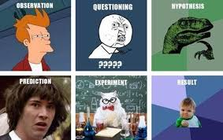
Wednesday 9/15/2021 - Activator
Directions: Get an AMP-IT-UP booklet off the front table and your journal. Copy the info in the blue boxes first and THEN use the booklet to help you MATCH the terms to the correct definitions.
A. Histogram | A change or difference in a condition
B. frequency | Everyone does each step the same way
C. variation | Shows the frequency that a specific outcome occurred
D. error | The number of times something happens
E. Standardized procedure | An unintentional procedural difference will cause this

Slide 19
Wednesday 9/15/2021 – Activator KEY
Directions: Get an AMP-IT-UP booklet off the front table and your journal. Copy the info in the blue boxes first and THEN use the booklet to help you MATCH the terms to the correct definitions.
A. Histogram | A change or difference in a condition
B. frequency | Everyone does each step the same way
C. variation | Shows the frequency that a specific outcome occurred
D. error | The number of times something happens
E. Standardized procedure | An unintentional procedural difference will cause this
C
E
A
B
D

Slide 20
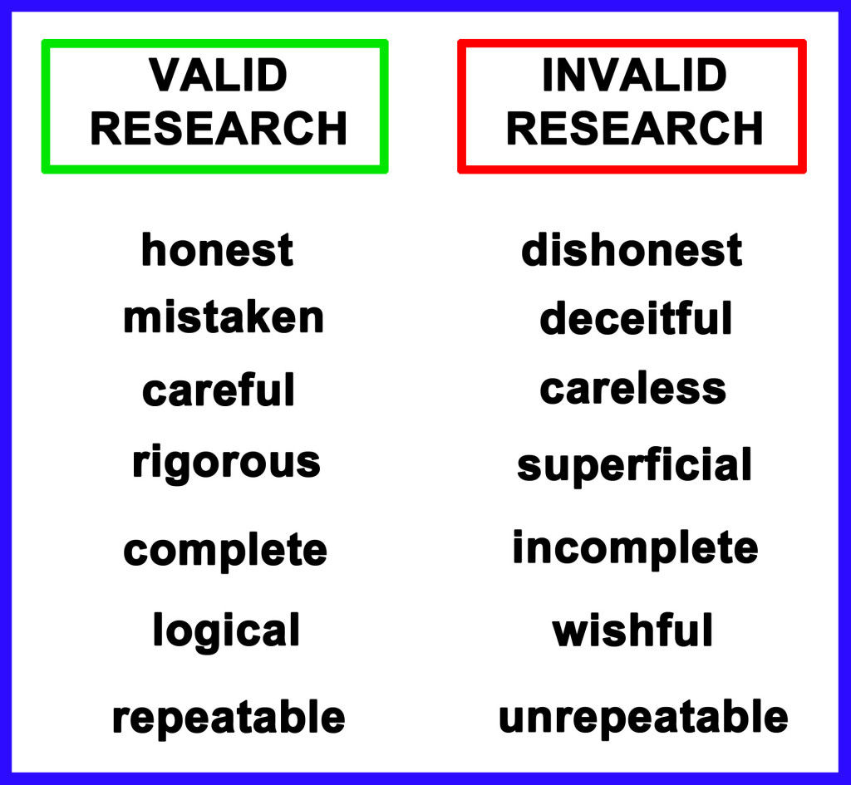
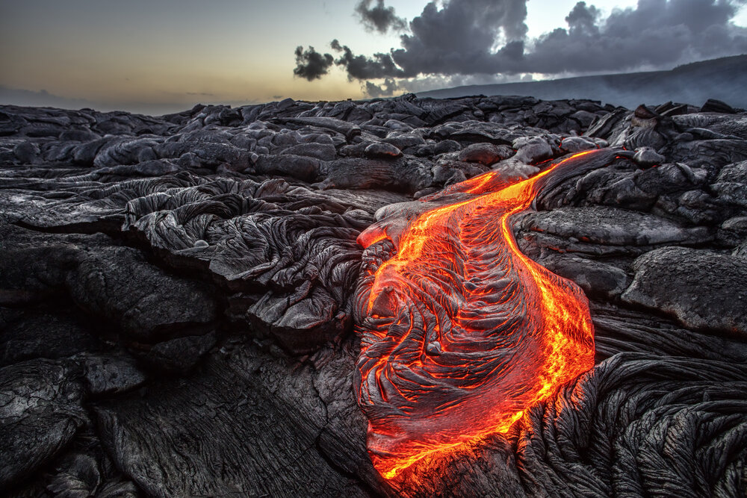
Wednesday 9/15/2021
Steps for today……..
Finish AMP-IT-UP Lava Flow Challenge
Compare to previous histogram data
Answer the challenge – Write the town hall a letter!
Lava Flow AMP IT UP Quizlet
Located in the General Channel post about quiz!!
Quiz on Friday over the lab!

Slide 21
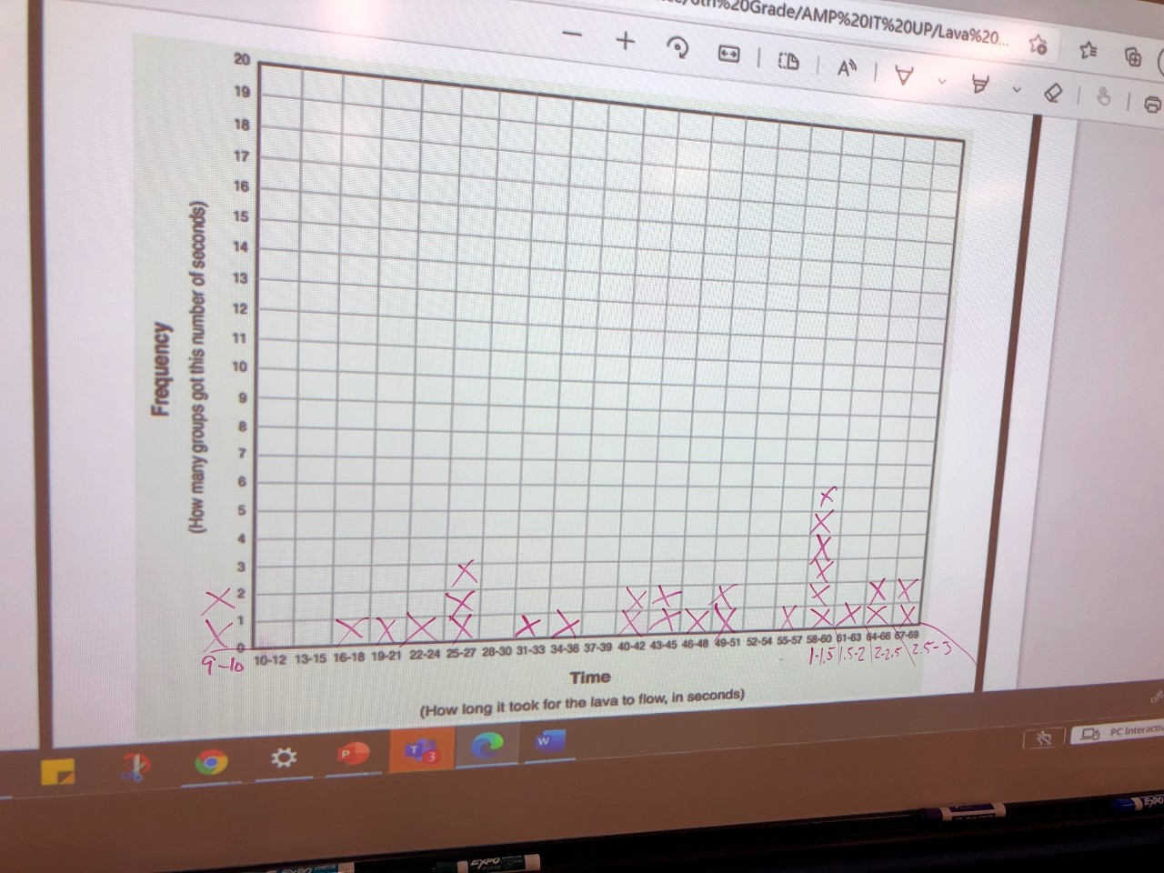
Wednesday 9/15/2021 – Period 1

Slide 22
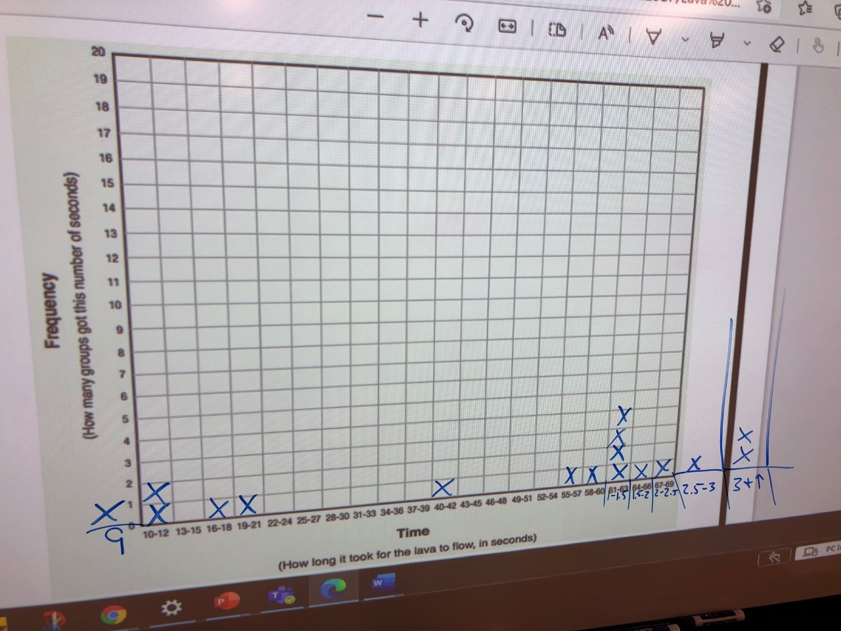
Wednesday 9/15/2021 – Period 3

Slide 23
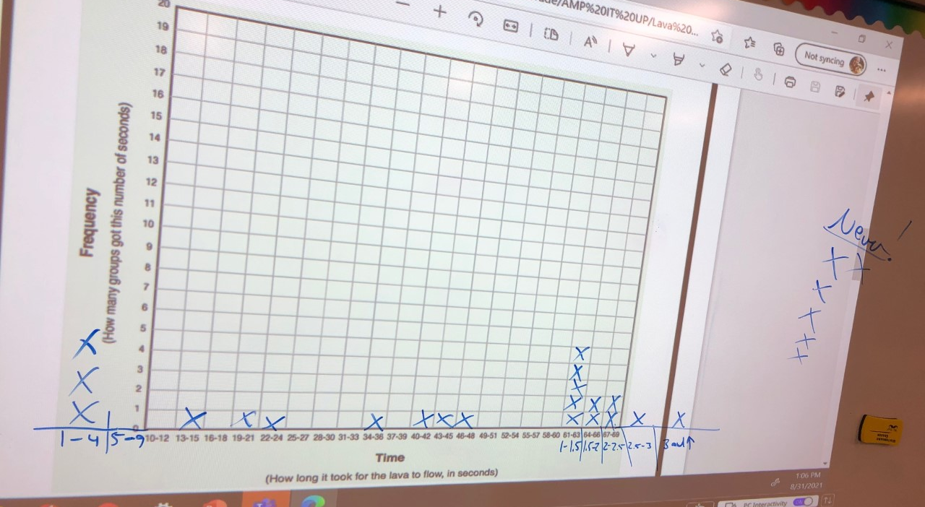
Wednesday 9/15/2021 – Period 5

Slide 24
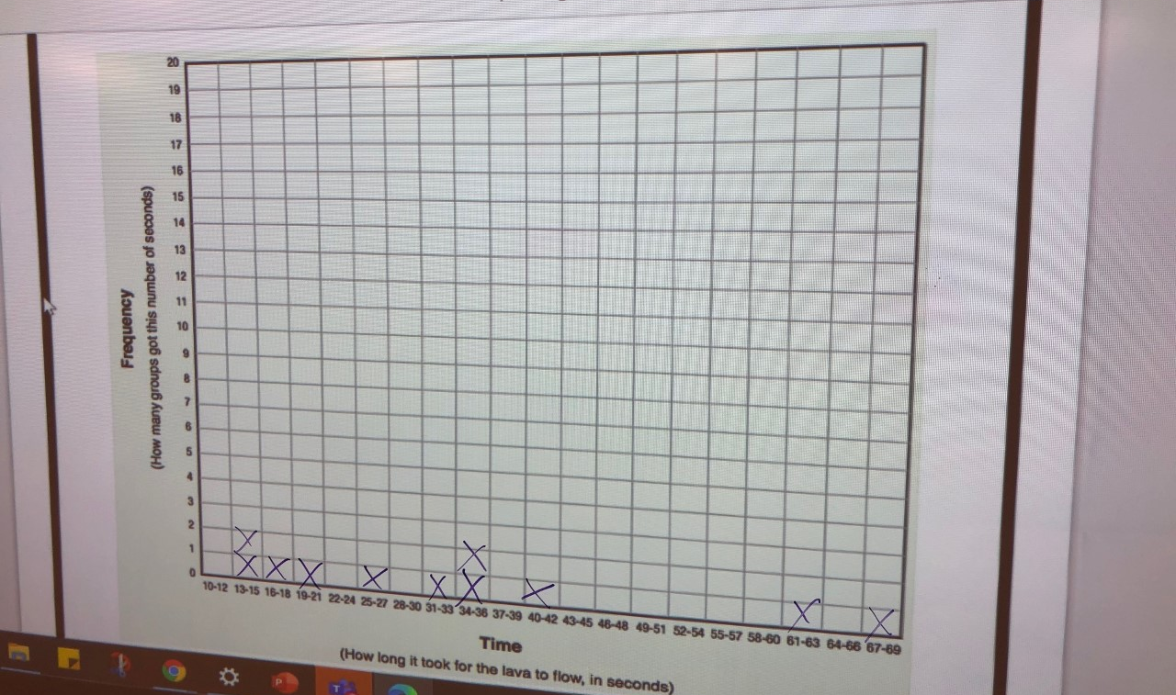
Wednesday 9/15/2021 – Period 6

Slide 25
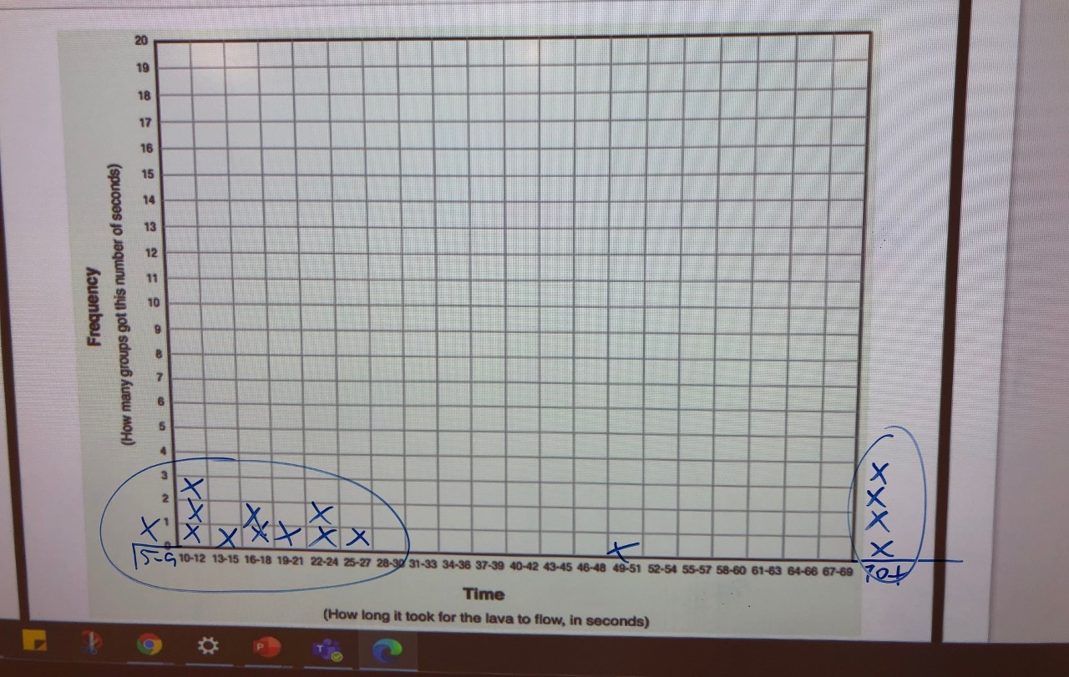
Wednesday 9/15/2021 – Period 7

Slide 26
Thursday 9/16/2021 – Activator
Directions: Get your science journal. Copy the statements and decide if they are true or false.
True or False | Statements
 | Following a standardized procedures produces more consistent and reliable results.
 | When we control variables, there is a lot of variation in the procedure.
 | The main purpose of the lab was to model a volcano.
 | A histogram shows the frequency or number of times a specific outcome happened.

Slide 27
Thursday 9/16/2021 – Activator KEY
Directions: Get your science journal. Copy the statements and decide if they are true or false.
True or False | Statements
 | Following a standardized procedures produces more consistent and reliable results.
 | When we control variables, there is a lot of variation in the procedure.
 | The main purpose of the lab was to model a volcano.
 | A histogram shows the frequency or number of times a specific outcome happened.
TRUE
FALSE
FALSE
TRUE

Slide 28
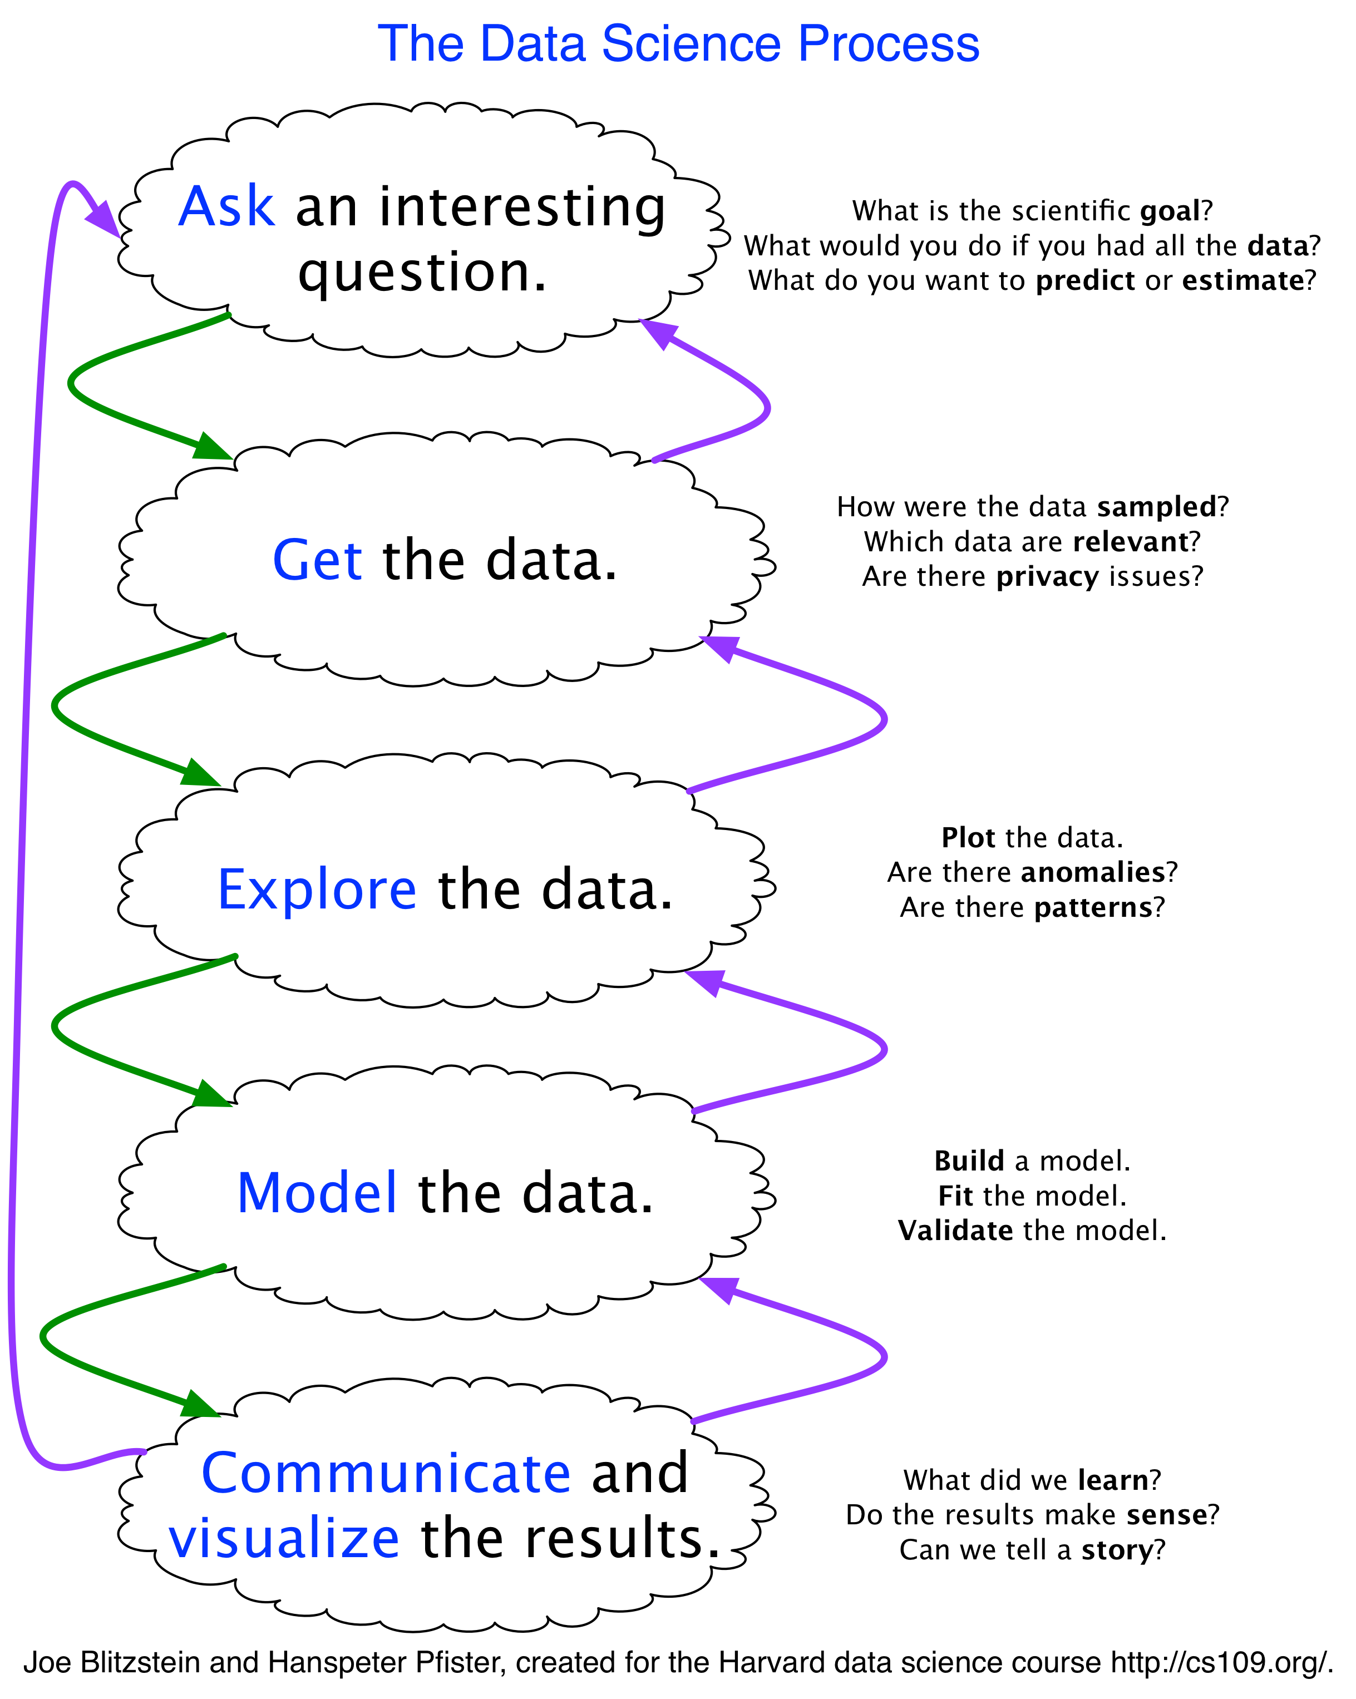
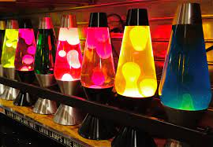
Thursday 9/16/2021
Steps for today…..
AMP-IT-UP Lava Flow Challenge
Compare each period’s final histogram data and the different standardized procedures used for the lava flow model
Lava Flow AMP IT UP Quizlet
Begin Lava Lamp Density reading and questions
Homework: Study for quiz on Friday-See post in Team’s General Channel for study resources!

Slide 29
Thursday 9/16/2021- Period 1

Slide 30
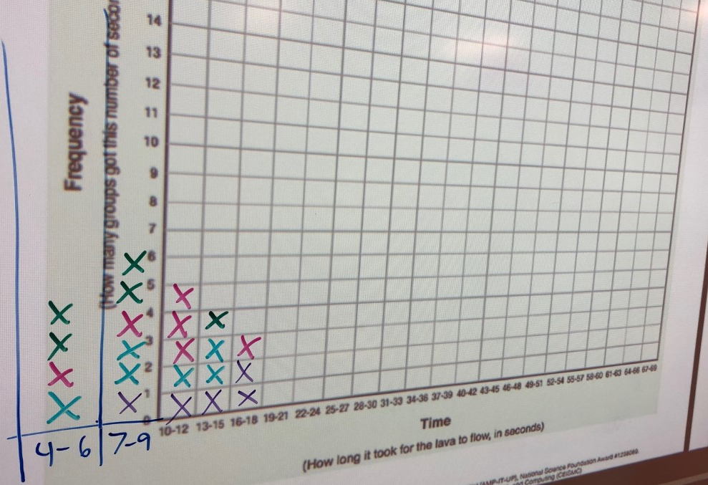
Thursday 9/16/2021- Period 3

Slide 31
Thursday 9/16/2021- Period 5

Slide 32
Thursday 9/16/2021- Period 6

Slide 33
Thursday 9/16/2021- Period 7

